Slide 1
Sampling:
Joins and Aggregation
Aviva Munshi and Nizan Howard

Slide 2
Research Question
Our Goal is to investigate sampling strategies for accelerating joins and group by aggregation queries. We wanted to emphasize on:
How do different sampling techniques affect the performance of queries with different joins and different group by aggregations?
If there is an effect, can they be shown in execution time?
The Data used is International Debt Statistics extracted from the World Data Bank.
Country Code
Debt
Country Name
Currency
Indicator Code
Year of Data Gathering
Indicator Name
Continent

Slide 3
Methodology
In order to answer our question, we used the following Sampling Techniques across different queries on Snowflake:
Simple Random Sampling: This involves randomly selecting a subset of rows from the table to execute a query.
Stratified Sampling: This involves dividing the data into strata (in our case, continents), and then performing random sampling within each stratum.
Systematic Sampling: This involves selecting every 393th row from the table. The idea is to take a smaller sample size systematically.
We then recorded the execution times for each of the queries, and plotted the observed variations. We’re using the Warm Cache Timing.

Slide 4
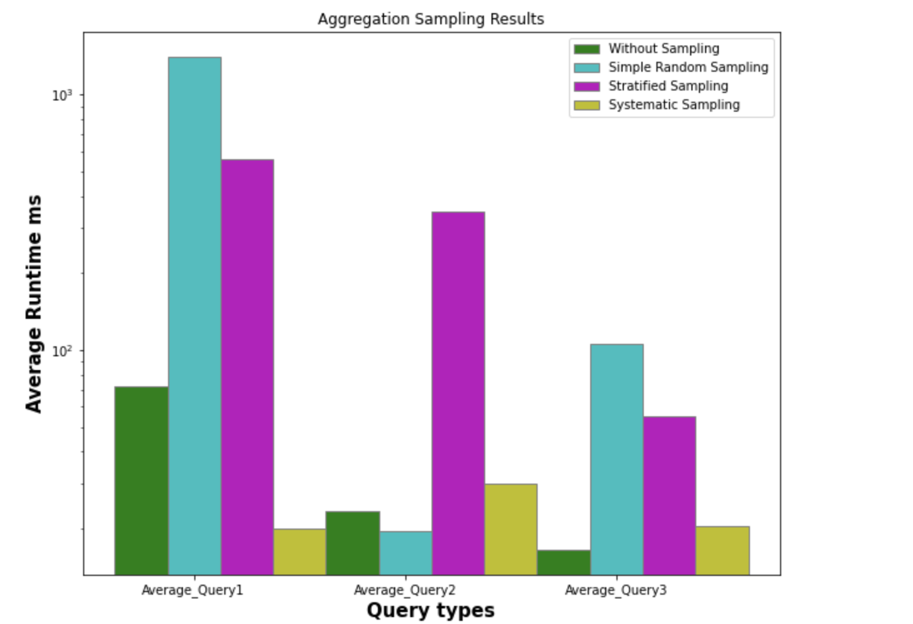
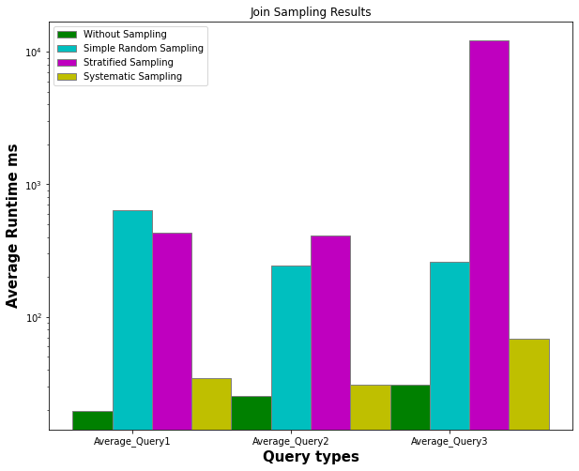
Runtimes
Simple Random Sampling:
We see a notable increase in query runtimes.
Stratified Sampling:
We see varied results.
Some queries show minimal impact, while others experience substantial increases in processing time.
Systematic Sampling:
Systematic Sampling improves runtimes compared to the baseline.

Slide 5
Inference
Simple Random Sampling:
Introduces randomness.
Impacts processing time significantly compared to the baseline without sampling.
Stratified Sampling:
Complexity influences performance diversely across query types.
Systematic Sampling:
Demonstrates consistency in performance.
Structured Pattern
Efficiency in Access
Simplified Implementation

